Slide 1

Designing websites
Lesson 4: Layout elements and web page design

Slide 2
Objectives
In this lesson, you will learn:
more about how web pages are defined and displayed
how to add borders and padding to an element
how to define the size of a layout element
design tips for creating a great website.

Slide 3
HTML document structure
An HTML document sets out the structure and content of a web page and there are certain things that it must contain.
It needs to start with the following code, which defines it as an HTML5 document, so that the browser displays it correctly: <!DOCTYPE html>
Immediately below this is <html> and the document ends with </html>.
The rest of the document is divided into two main elements, the <head> and the <body>.

Slide 4
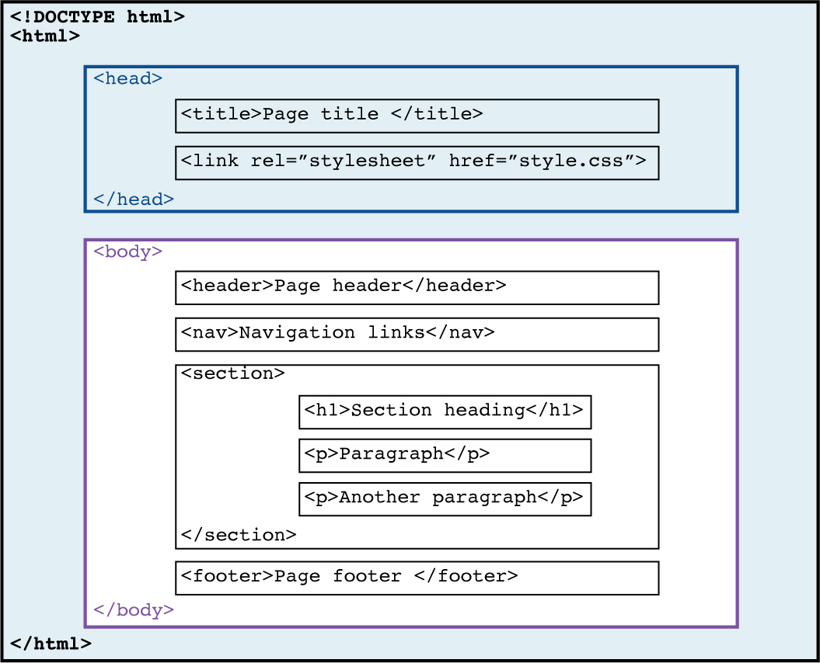
The layout of an HTML page

Slide 5
The <head>
The <head> element contains information about the page.
There are two elements that we are going to use here:
<title>
This is the title of the document that is displayed in the browser's title bar or page tab.
It can only contain text, and is used by search engine algorithms when listing pages in search results.
For example: <title>Favourite biscuit recipes</title>.
<link>
This links the document to an external style sheet.
For example: <link rel="stylesheet" href="styles.css">.
The <link> element does not have a closing tag.

Slide 6
The <body>
The <body> element contains all the content of the web page, including text, images, videos and hyperlinks to other pages and websites.
Only the content inside the <body> element will be displayed by the browser.

Slide 7
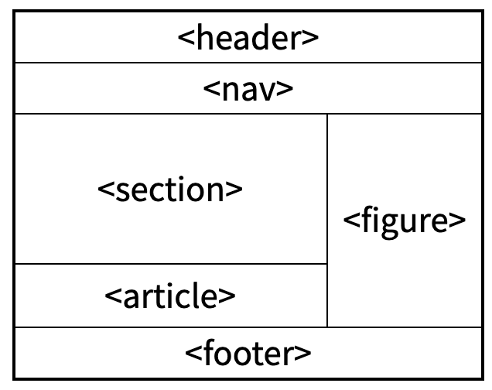
HTML semantic elements
Various semantic elements are used within the <body> element. Each one is like a box and its name describes its purpose and content:
Defines a header for a whole web page or a section of a web page.
Defines a set of navigation links.
Defines a section of the web page and can contain headings, paragraphs, images, videos and hyperlinks
Defines some independent, self-contained content. It can also contain headings, paragraphs, images, videos and hyperlinks.
Specifies self-contained visual content like diagrams, photos, etc.
Defines a footer for a document or section.

Slide 8
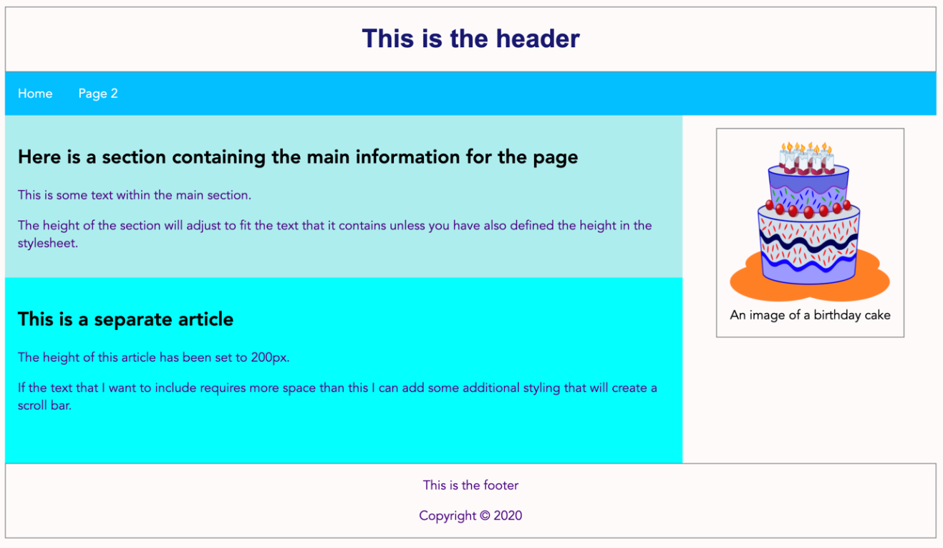

Slide 9
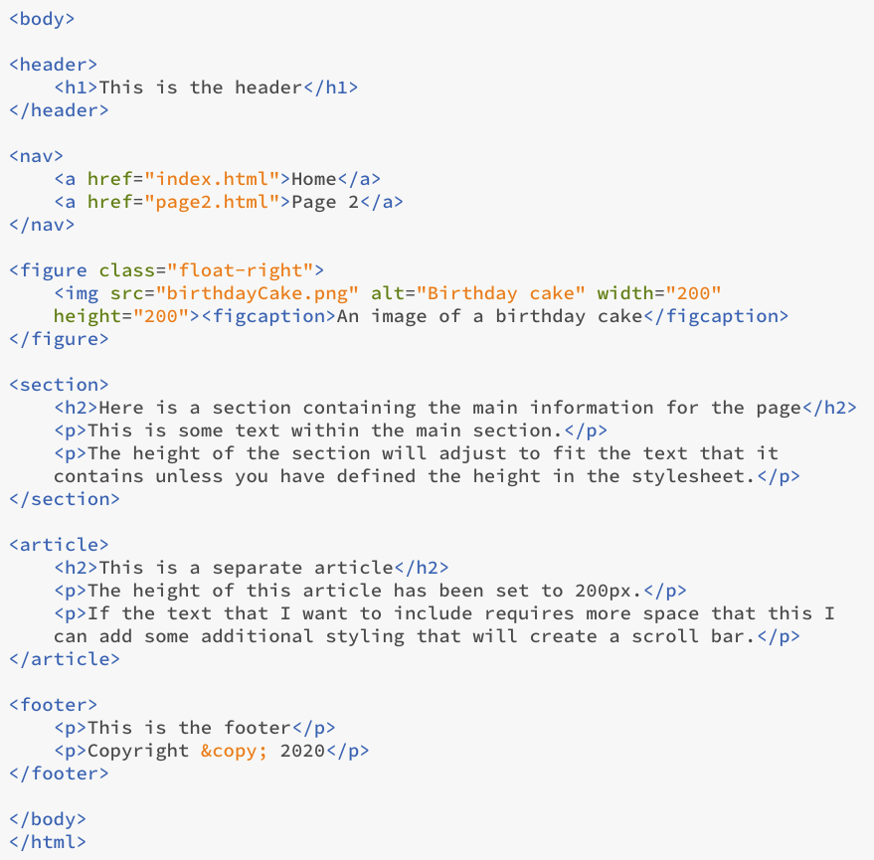

Slide 10
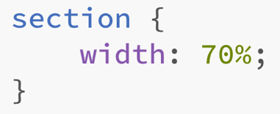
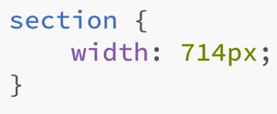
Defining the width of an element
By default, most elements take up the full width of the screen. However, setting the width allows you to control the layout.
The width can be defined as a percentage of the total width, which is better if your website will be viewed on different-sized screens, or as a set value in pixels.
For example:
The height of an element automatically adjusts to fit its contents, so it is only necessary to define the height if a specific height needs to be maintained.

Slide 11

Activity 4.2: Setting the width and layout of elements

Slide 12
Adding borders
To add a border to an element we use the CSS property border.
There are three attributes of a border that can be defined:
width: a value in pixels, or simply thin, medium or thick
style: solid for a line
colour: a colour name to complement the background colour.
For example:
border: 2px solid Black

Slide 13
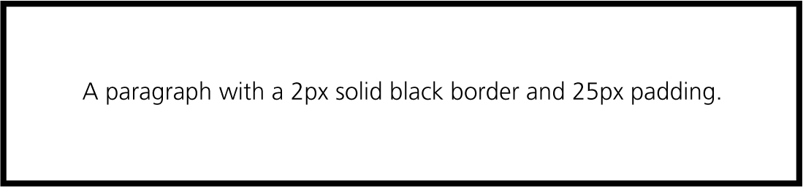
Adding padding
Padding is used to add space between the border and the contents of the box it defines.
For example:
padding: 25px
This improves the layout and makes text inside the border easier to read.
To maintain the width and height of an element so it doesn't get wider and deeper when you add a border and padding, add the following property to the styling: box-sizing: border-box;

Slide 14
Activity 4.3: Adding borders and padding

Slide 15
Activity 4.4: Personalising the styling

